Slide 1

H &M BRAND OVERVIEW
Excel Project
Submitted by pragati Chaskar

Slide 2
INTRODUCTION :
The project involves analyzing sales data from H&M products over the past two years.
The data includes various product details, sales figures, categories, and other relevant information.
The objective of this project is to organize, clean, and analyze the data using Excel functions, tools, and features such as Goal Seek, Solver, and Pivot Tables to draw insights and make data-driven decisions.

Slide 3
Basic Formatting
Text Wrapping: Enabled for all cells to ensure complete data visibility.
Colour Formatting: Used a red shade to highlight cells, aligning with H&M’s logo colour.
Centre Alignment: Ensured all text is cantered for a uniform look.
Borders: Added borders to all tables to clearly separate data points.
Headers: Made bold, centred, and slightly larger than the rest of the text to stand out.
Font Styling: Changed the font style and size across the table and used different colours.
Freeze Panes : Used Freeze panes option to ensure I didn't lose the header of the data.

Slide 4
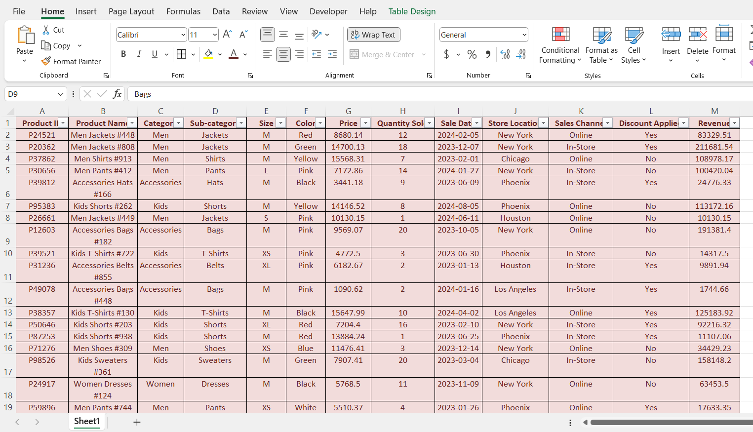

Slide 5
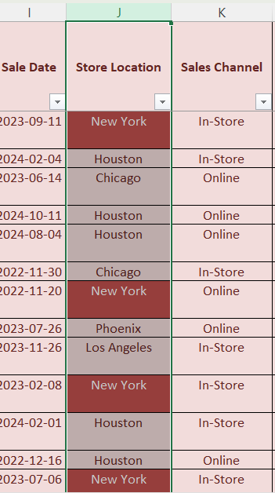
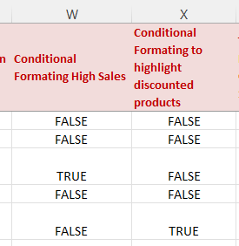
Conditional Formatting:
Highlight New York :
Conditional formatting was applied to the "Store Location" column, using a "Text contains" rule for the value "New York". Cells containing "New York" were formatted with a pink background and white text.
Highlight High Sales: Applied formatting to emphasize products with high sales.
Formula: =H2 >= 10
Identify Discounted Products: Highlighted products that had discounts.
Formula: =L2 = "Yes"

Slide 6
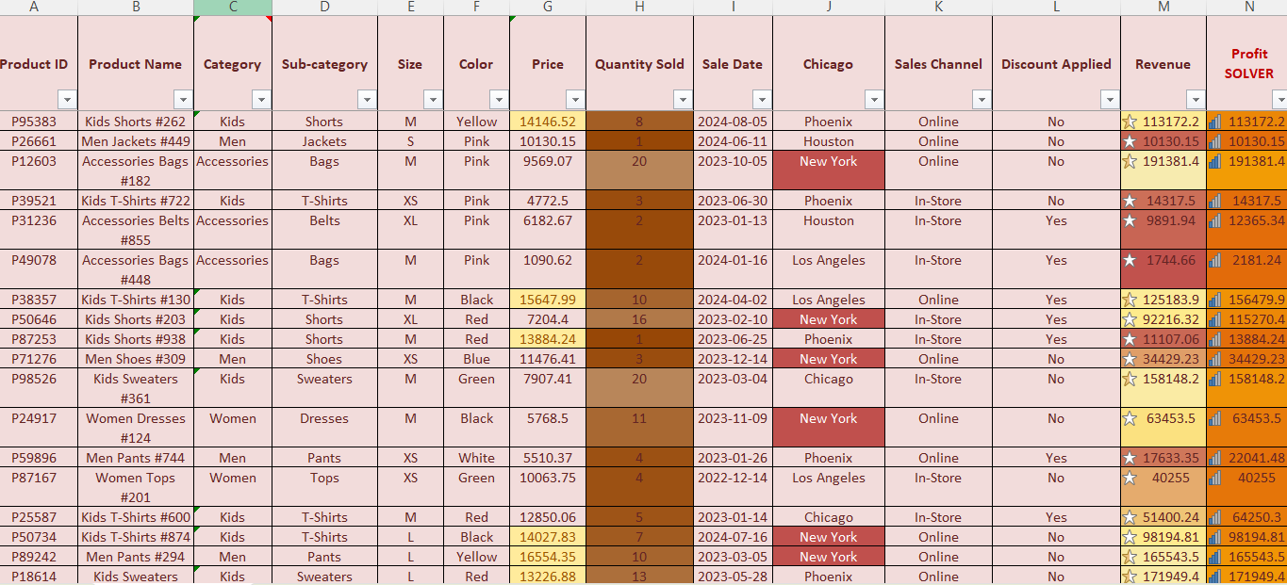
Conditional Formatting:
Colour Scale for Quantity Sold: Used a gradient from white (low sales) to brown (high sales).
Icon Set for Revenue: Displayed icons to indicate revenue levels, with darker shades showing higher revenues.

Slide 7
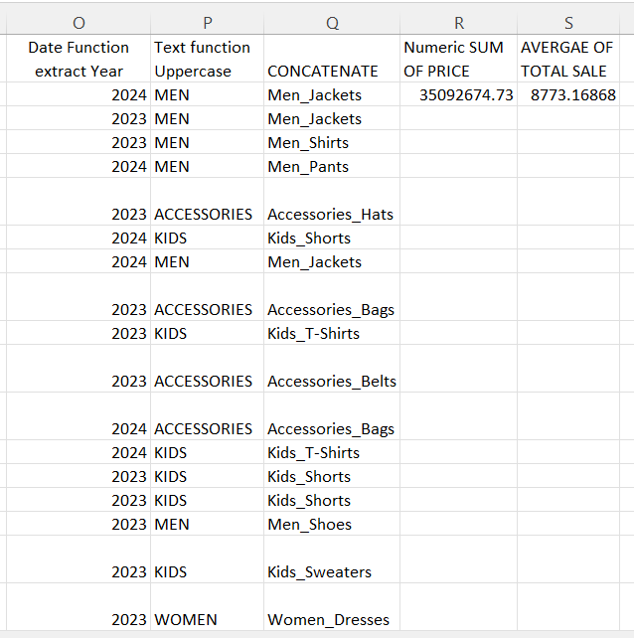
Excel Functions and Formulas Used :
1. Date Function: Extract Year
To extract the year from the sale date, the following formula was applied:
=YEAR(I2)
2. Text Function: Convert Text to Uppercase
Converted product names to uppercase for consistency:
=UPPER(C2)
3. CONCATENATE Function: Combine Category and Subcategory
Merged categories with subcategories for a detailed view:
excel
=CONCATENATE(C2, "_", D2)

Slide 8
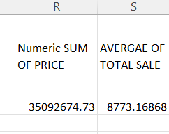
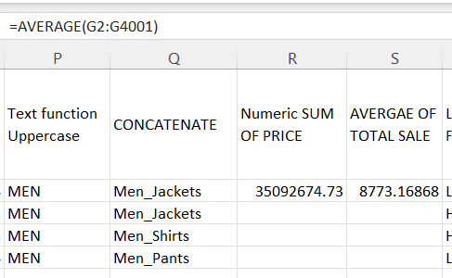
Excel Functions and Formulas Used :
Aggregate Function
SUM Function: Calculate Total Sales
To find the SUM OF TOTAL SALES:
=SUM(G2:G4001)
To find AVERGAE OF TOTAL SALE:
=AVERAGE(G2:G4001)

Slide 9
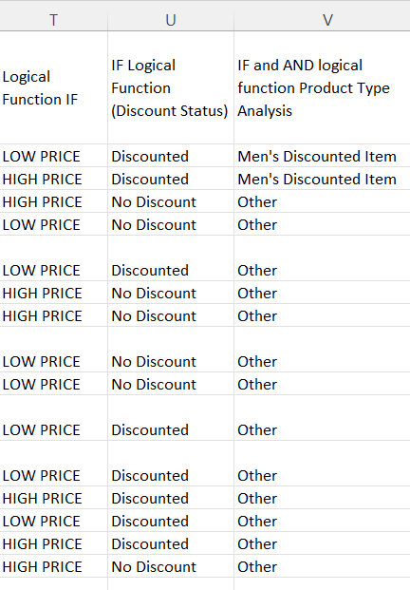
Excel Functions and Formulas Used : By using IF
Logical Function: Identify Price Levels
Classified products as “High Price” or “Low Price” based on sales price:
=IF(G2 > 10000, "HIGH PRICE", "LOW PRICE")
Logical Function: Discount Status
To check if a discount was applied:
=IF(L2 = "Yes", "Discounted", "No Discount")
Product Type Analysis : IF & AND
Combined multiple conditions to determine if the product was a men’s item and had a discount:
=IF(AND(C2 = "Men", L2 = "Yes"), "Men's Discounted Item", "Other")

Slide 10
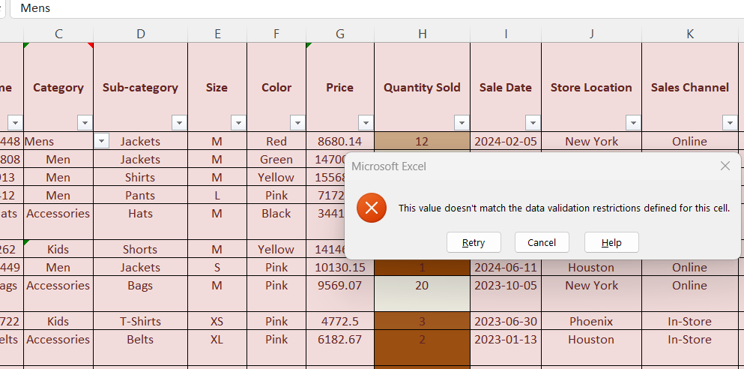
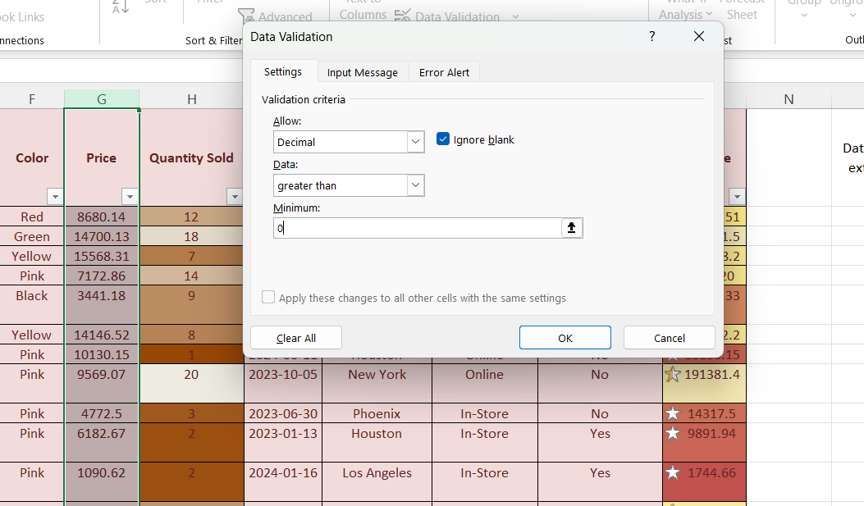
Data Validation:
Category Restriction: Allowed only predefined categories ("Men," "Women," "Accessories," and "Kids") to maintain data consistency
Numeric Value Constraints: Restricted "Price" column to positive numbers only.

Slide 11
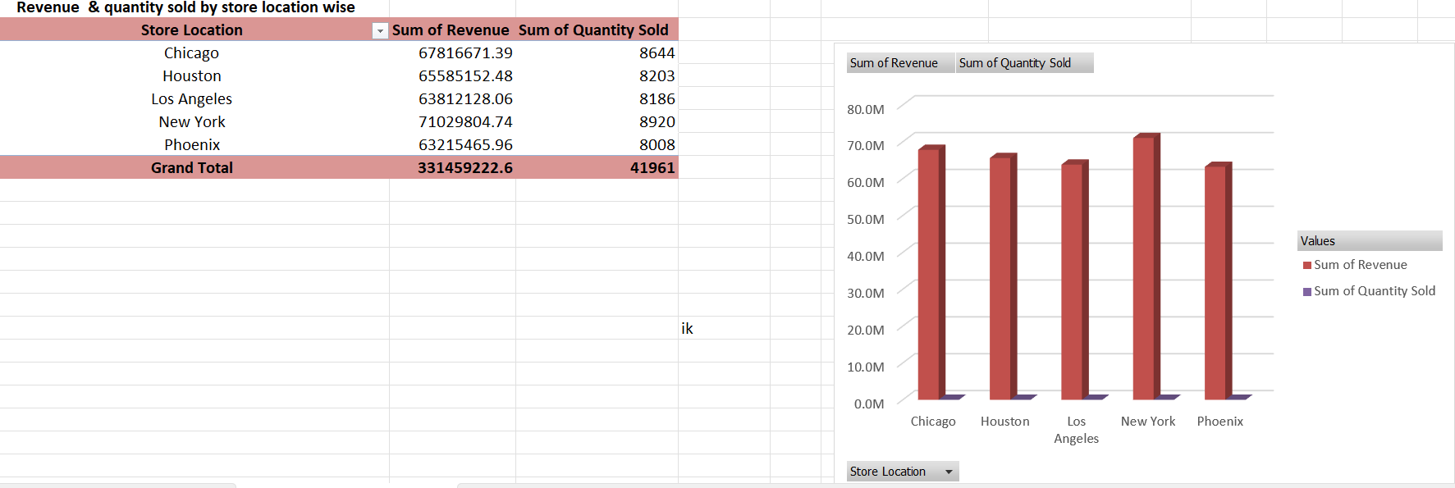
Advanced Excel Tools
Pivot Table
Location-wise Sum of Revenue and Quantity Sold

Slide 12
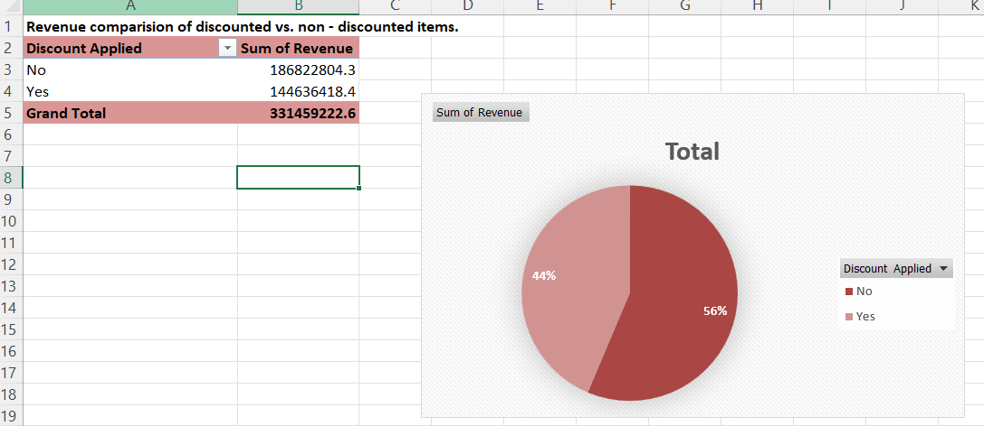
Revenue Comparison: Discounted vs. Non-Discounted
Compared total revenue from discounted and non-discounted items by dragging "Discount Applied" to Rows and "Revenue" to Values.

Slide 13
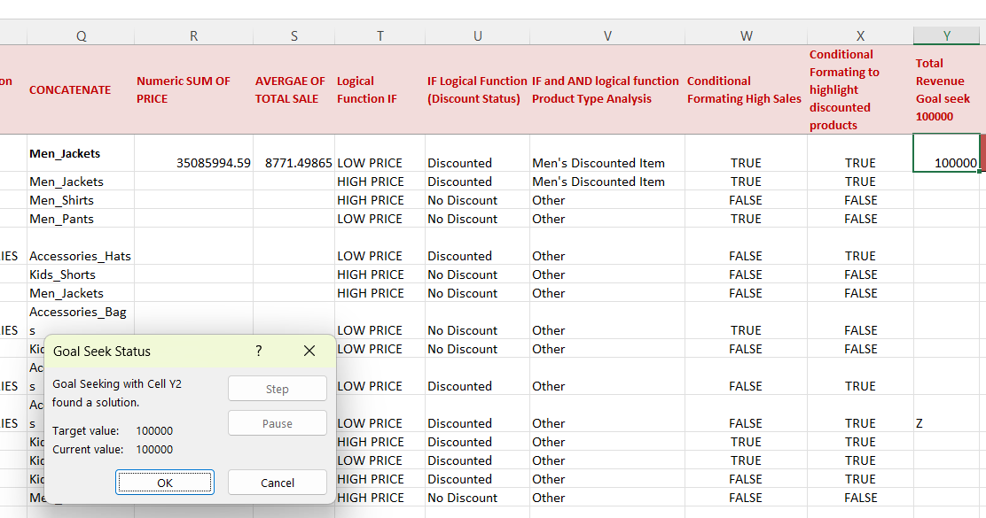
Goal Seek:
Set Revenue Target
Adjusted the "price" to meet a revenue goal of 1,00,000 using the following setup:
Set Cell: Y2 (Total Revenue)
To Value: 1,00,000
By Changing: G2 Price

Slide 14
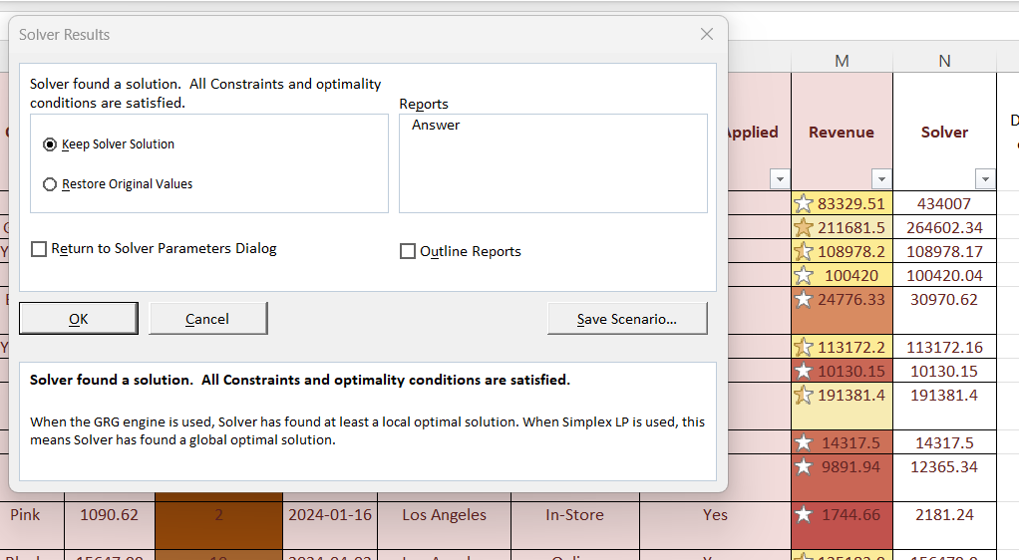
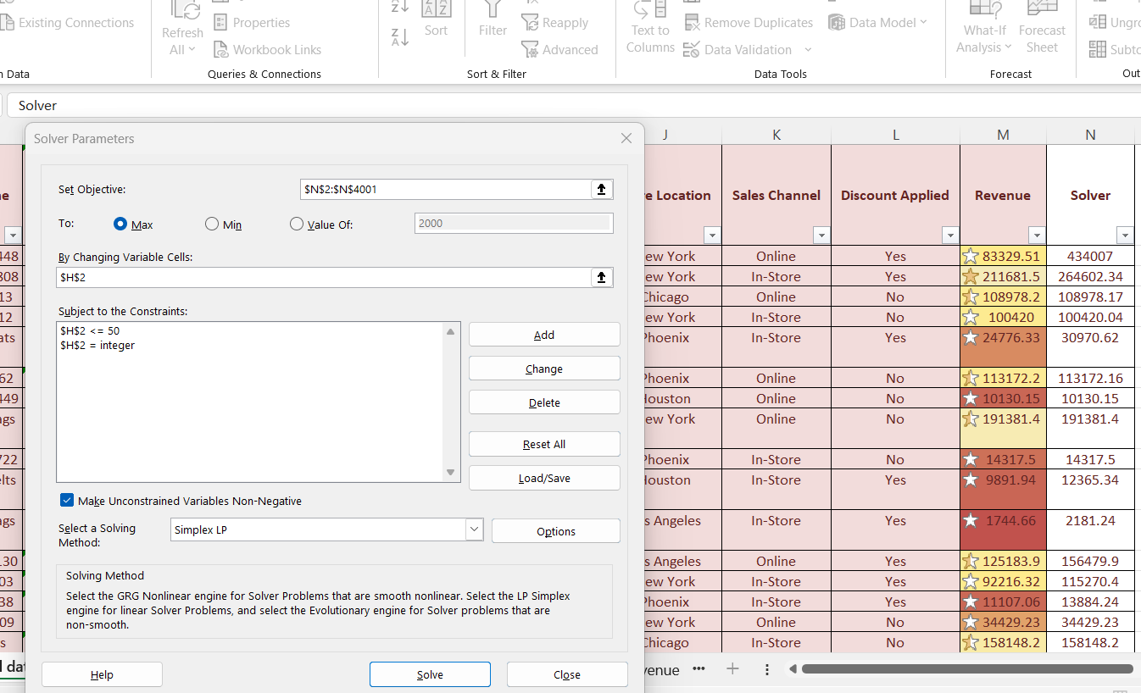
Solver:
Maximize Total Revenue
Used Solver to maximize revenue by adjusting "Quantity Sold" (H2) while considering constraints like inventory limits: to get the profit of 200000 will use solver automatically solver will suggest price as per the profit requirements.
Objective Cell: N2 (=G2 * H2)
=[@Price]*[@[Quantity Sold]]
Maximize Total Revenue
Constraints:
Value of 200000
H2 must be ≤ 50 (max inventory)
H2 must be an integer

Slide 15
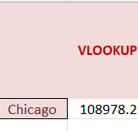
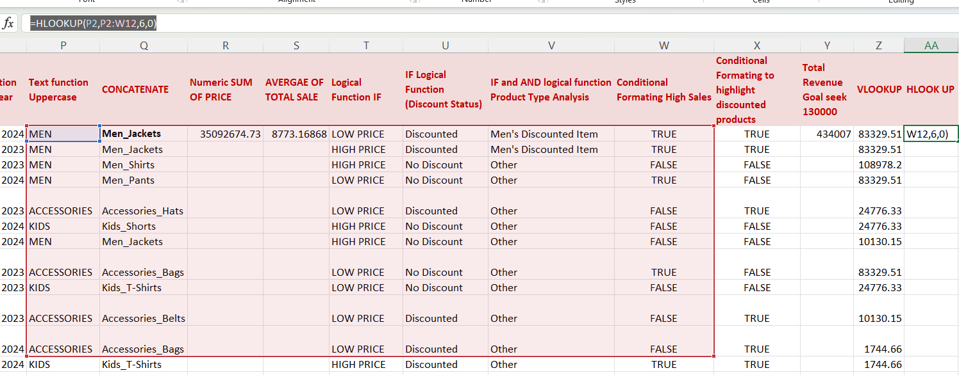
VLOOKUP for Revenue Retrieval
Used VLOOKUP to fetch revenue based on store location:
=VLOOKUP(Z2, J:M, 4, FALSE)
HLOOK UP:
Using the HLOOKUP function in Excel, we retrieved specific data points, such as "Kids," which helps us analyse the sales distribution for this category.
The formula used was
=HLOOKUP(P2, P2:W12, 6, 0), where "P2" refers to the selected category, and the formula correctly returns the matching category in uppercase.

Slide 16
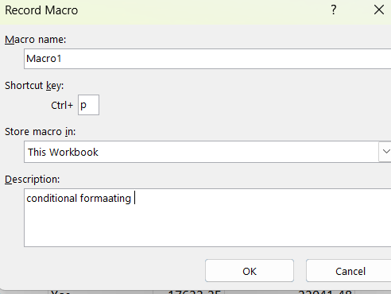
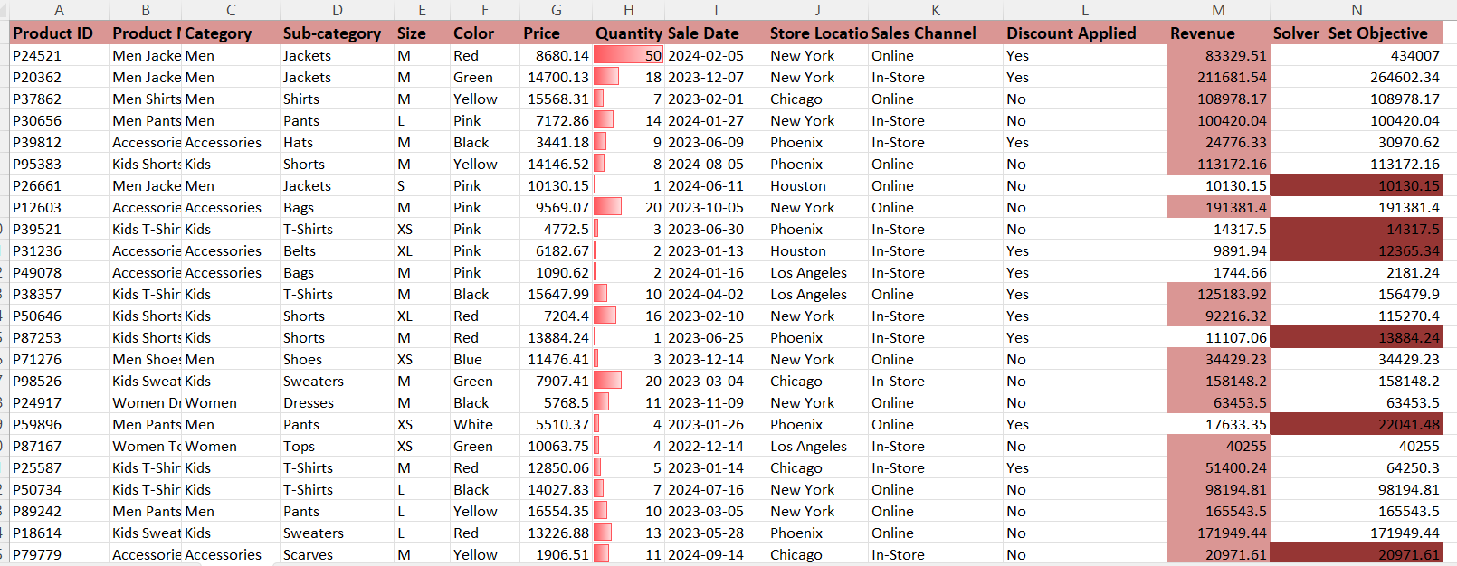
Macros:
I created a macro to perform tasks on the original dataset, including conditional formatting and other functions. I then ran the same macro on a duplicate sheet, which replicated the tasks I recorded on Sheet 1. I assigned the macro to the keyboard shortcut Ctrl+P.

Slide 17
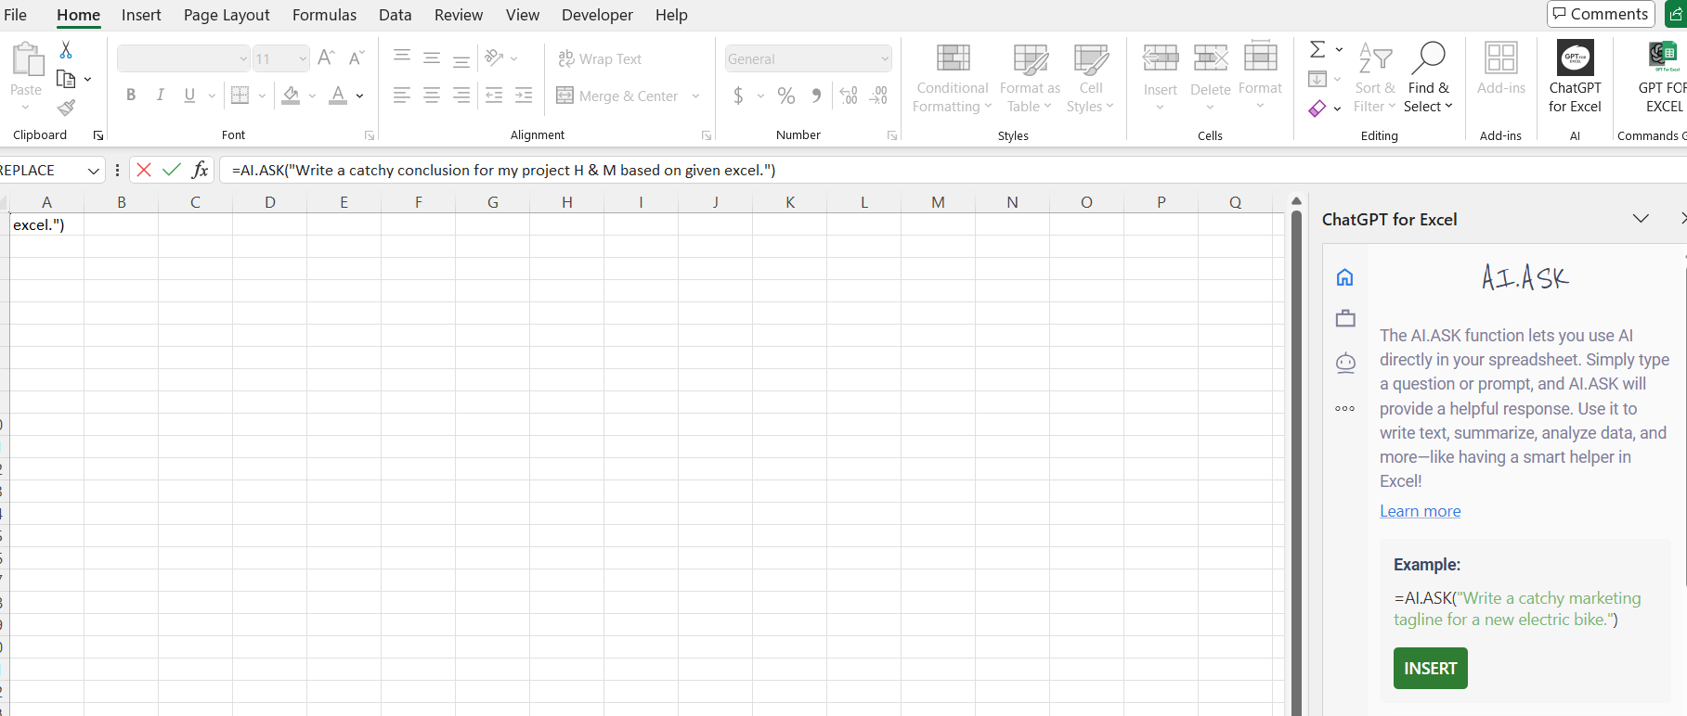
Chat GPT for Excel:
I connected with ChatGPT's free version to request an analysis of the given project. ChatGPT with Excel can assist by generating insights, explaining formulas, and providing step-by-step guidance on tasks. Additionally, ChatGPT can help automate repetitive tasks and offer data analysis support, making it a valuable tool for working with large datasets.

Slide 18
Conclusion :
The H&M product data analysis project has been successfully completed, utilizing various Excel functionalities to clean, format, and analyse the data.
From basic functions to advanced tools like Solver and Goal Seek, the project allowed for a comprehensive analysis of sales data, highlighting trends, and drawing insights.
Key Findings:
Revenue Patterns: Analysed which products and locations generated the most revenue.
Discount Impact: Understood how discounts affected sales volumes.
Inventory Planning: Optimized quantity sold using Goal Seek and Solver to maximize revenue under certain constraints.
These insights can help H&M refine their sales strategies, optimize inventory, and increase profitability.

Slide 19
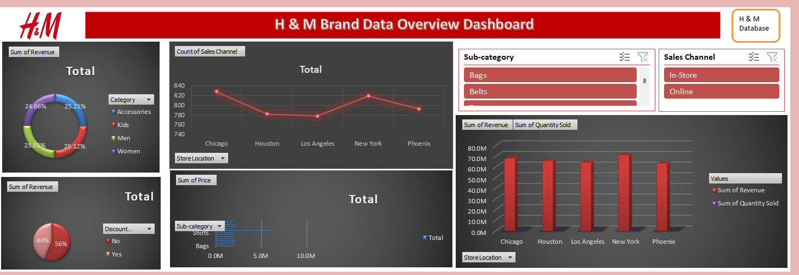
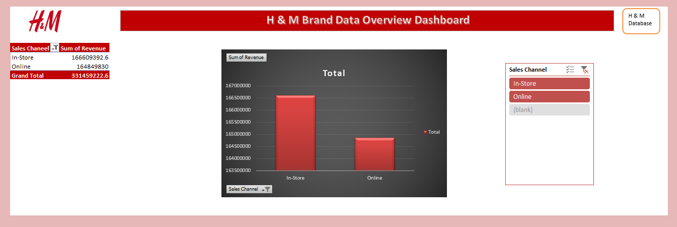
Dashboard for H & M Brand Data Overview:
I created a dashboard for an overview of the H&M brand, incorporating slicers and charts connected to pivot tables using report connections. This setup allows data to automatically update based on the selected criteria. I also added buttons that link directly to the original datasets.

Slide 20
Thank You…
HM_Brand_Sales_ PROJECT (pragati).xlsx

